Slide 1
Disney College Program
Overview
at-a-glance
2023
Informational overview

Slide 2
Hands-on experience working in wdw
4–6month internship w/ opportunity to extend
Relationships with leadership opportunities and big resume builder
What is the DCP?
Variety of roles on property
  Merchandise
  QSR/QSFB
  Custodial
  Skyliner Ops
  Attractions
  Children’s Activities
  Recreation
  Lifeguard
  Houseperson
  Character Performer*
  Etc.

Slide 3
to note:
Eligibility:
Programs:
Disney College Program
Disney Professional Internship
Disney Culinary Program
International College Program
Cultural Exchange Program
College accredited student
Completed one semester of schooling
Graduated (up to eighteen months after)

Slide 4
Types of Programs
fall
Spring
August - January
Advantage: May/June – January
extension
January to June
Advantage: January to July/August
extension

Slide 5
Importance?
Big Resume Builder
Well – known company such as a WDW Resort
Customer service in every role/aspect
Lifetime of knowledge & memories
Lead to potential employment opportunities within company/field

Slide 6
Application Process
~laptop/computer~
Application
Phone Interview *
Acceptance or NLIC

Slide 7
Fees
Financially Ready.
Acceptance Fee: $431
  Deposit
  Rent
Car Decal: $185
Per Jan. 2023
Fees split into two:
$240 program fee
$191 rent

Slide 8
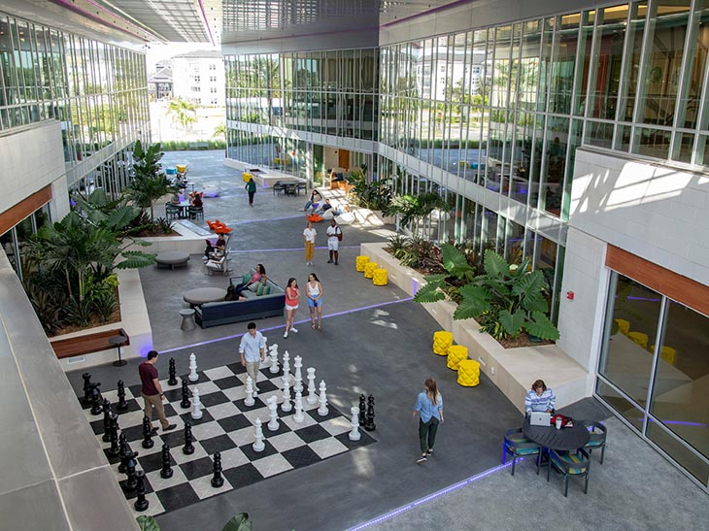



Housing
Flamingo Crossings Village
  East
  West
Communities
  Archimedes, Bagheera, Cheshire, Doc, Edna, Figment, Genie, Hopps, Iago, Jiminy Cricket
Unit Types
  2x2, 4x2, 4x4
Rent
  Weekly
Personal Housing

Slide 9
Perks
At-a-glance
Weekly Pay
Rate: $16/hr.
(current as of Jun. 2023)
Merchandise & Dining Discounts
Complimentary Admission Park Entry
Reservation System
Chip & Dales
Knowledge/Resume Builder

Slide 10
College
Courses
College Credit
Study Hours
2 hours – 2 days a week
Off Semester | Courses
Semester off: FAFSA / Scholarships
  Disney College Program remains recommended for up to nine (9) credits by the American Council on Education
  Disney Programs performance evaluation that can be completed for participants needing one as a part of an internship requirement. Important…All they need to do is formally request one from a leader in their work location 2-4 weeks prior to their departure date.

Slide 11
Zoom Sessions:
Tuesday Sept 26 | 3:00-3:45PM
Wednesday Sept 27 | 12:00-12:45PM
Thursday Sept 28 | 3:00-3:45PM
https://events.zoom.us/ev/AmX4om68FqBVoNHfLyZj7ywdjDk_XDX78plKoHp9AZt5e4TPOsRf~AggLXsr32QYFjq8BlYLZ5I06Dg

Slide 12
Contact Information
SVSU Career Services
Direct Liaison: Teresa George
Email: tmgeorge@svsu.edu
SVSU Disney Alumni Association
Instagram: @svsu_disneyalum
Gmail: svsu.disneyalum@gmail.com
Phone: 989.964.4948
Disney College Program Support Page
  support.disneyprograms.com

Slide 13
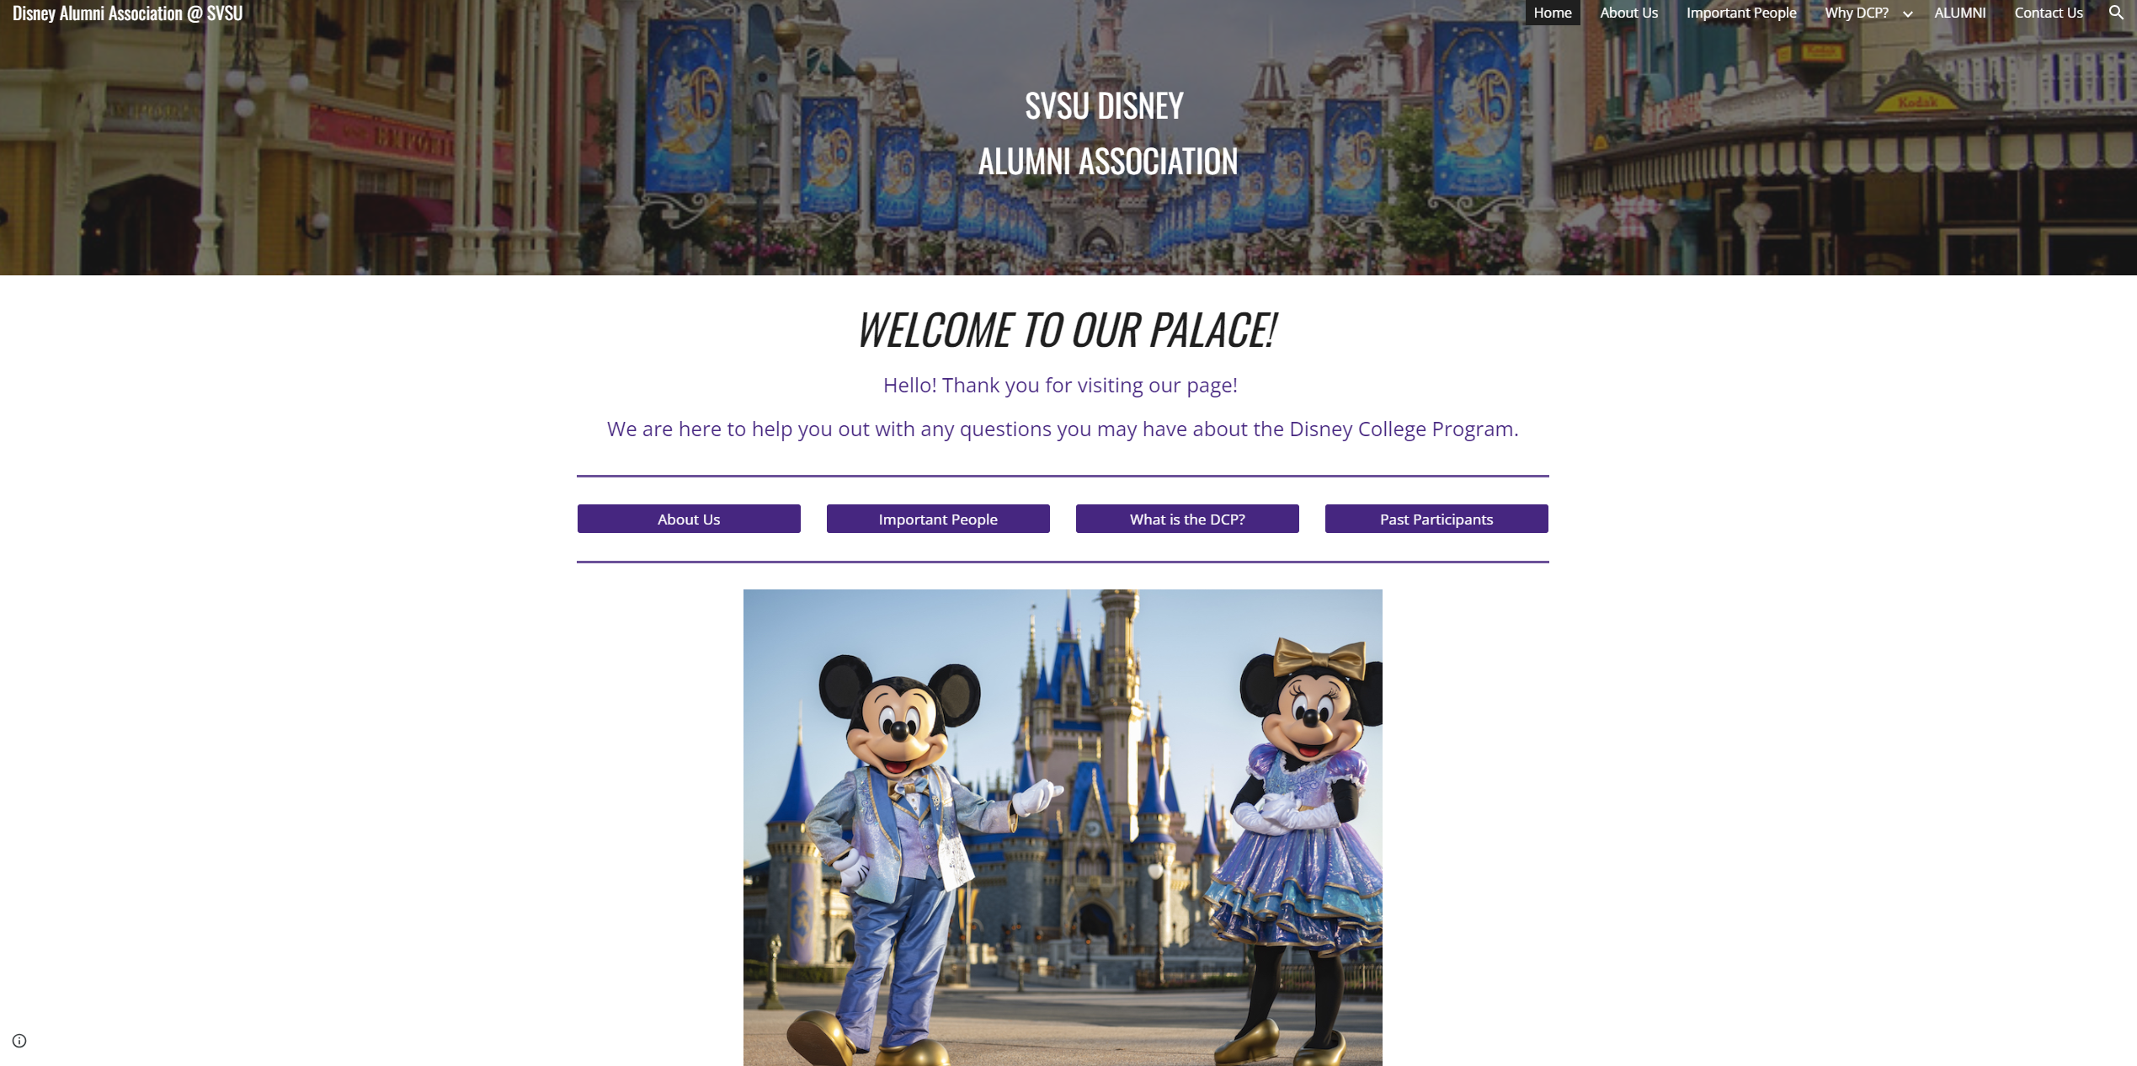
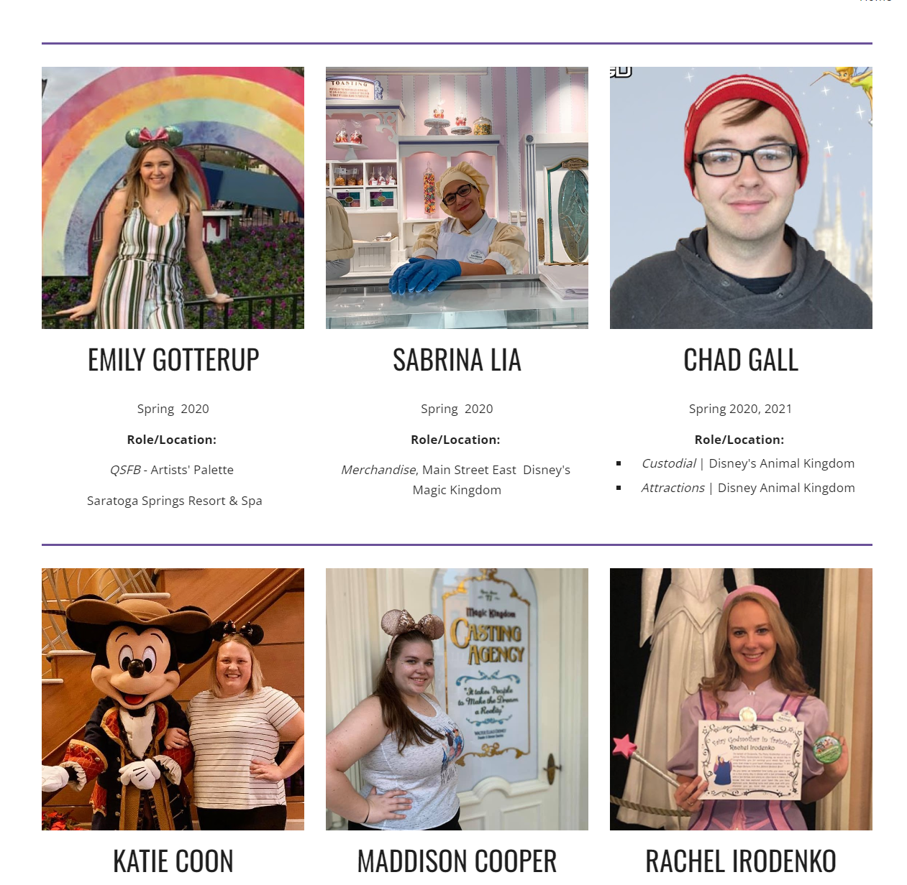
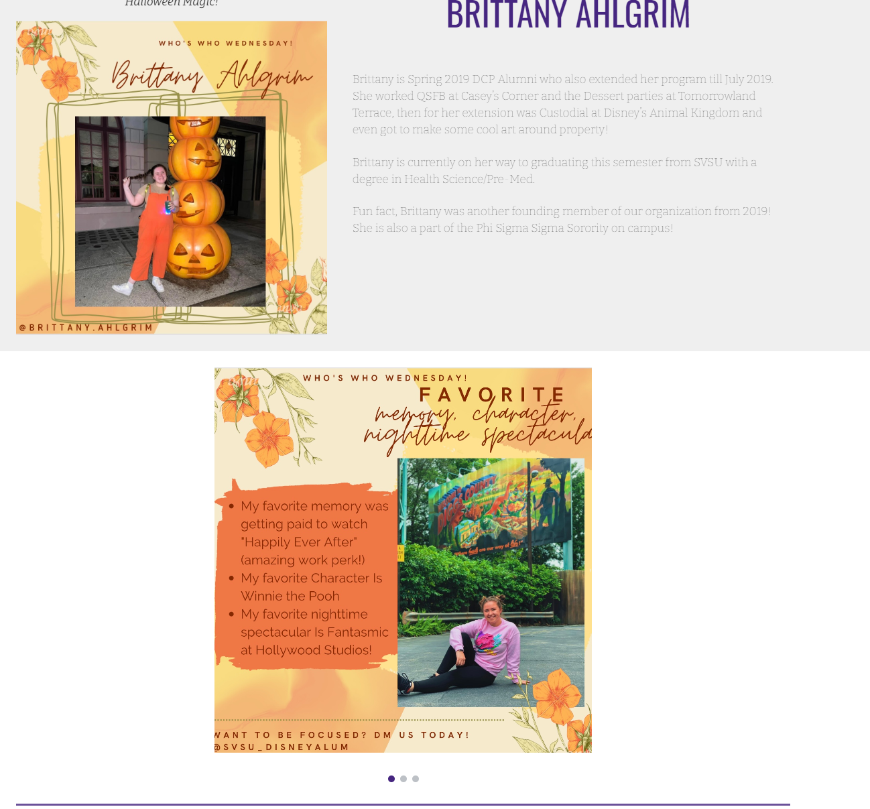
https://sites.google.com/view/svsudisneyalumni

Slide 14
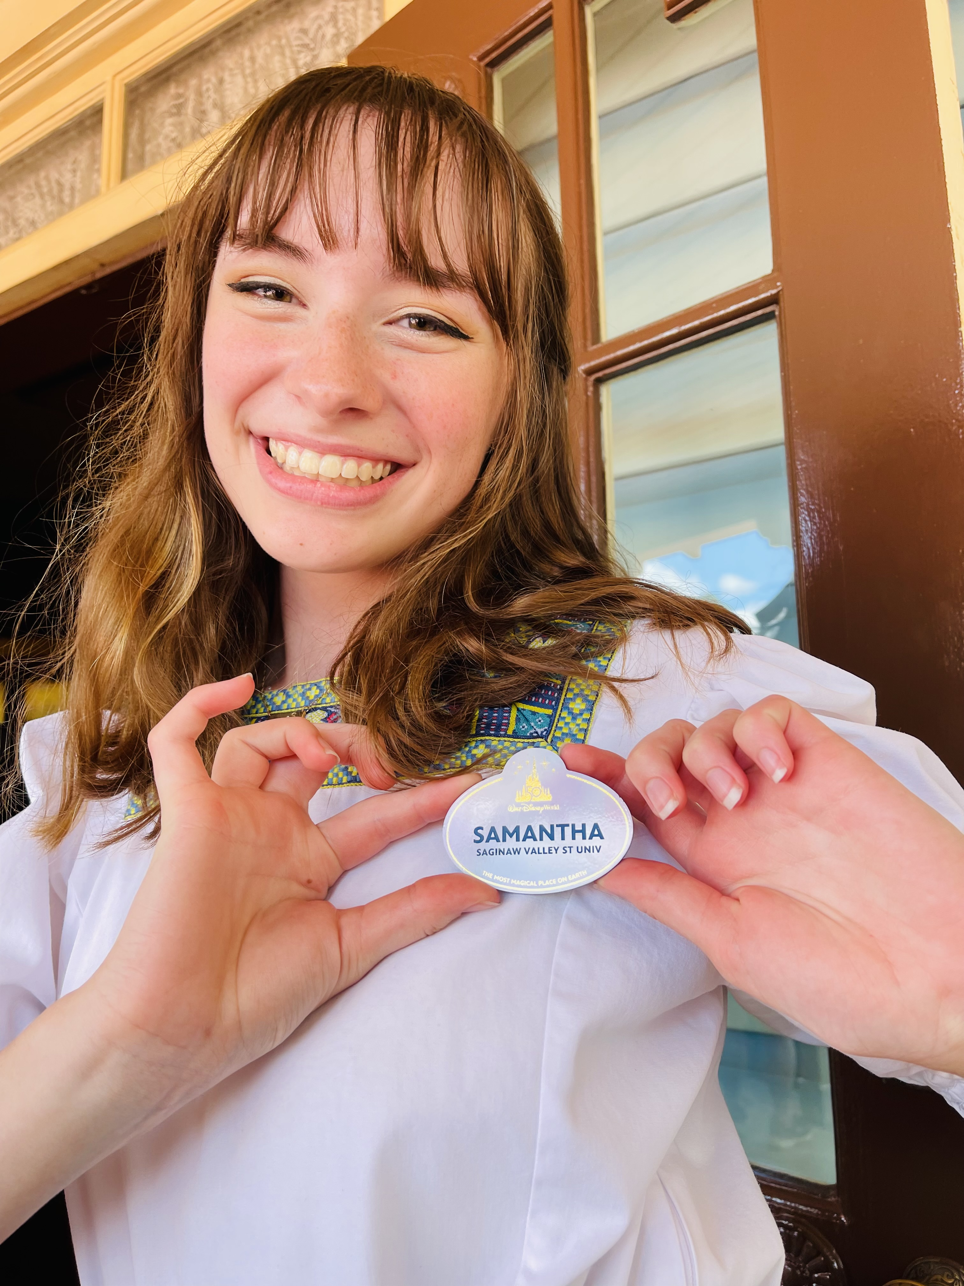
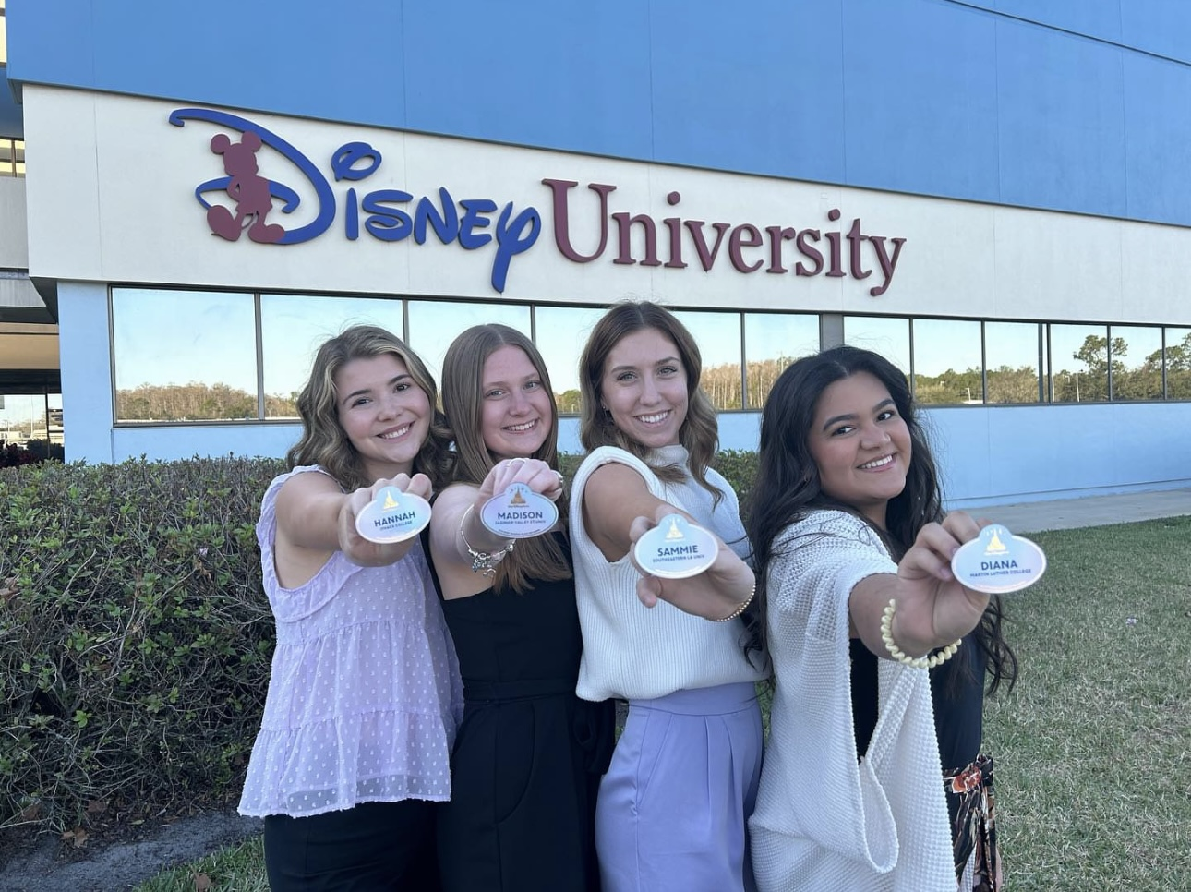
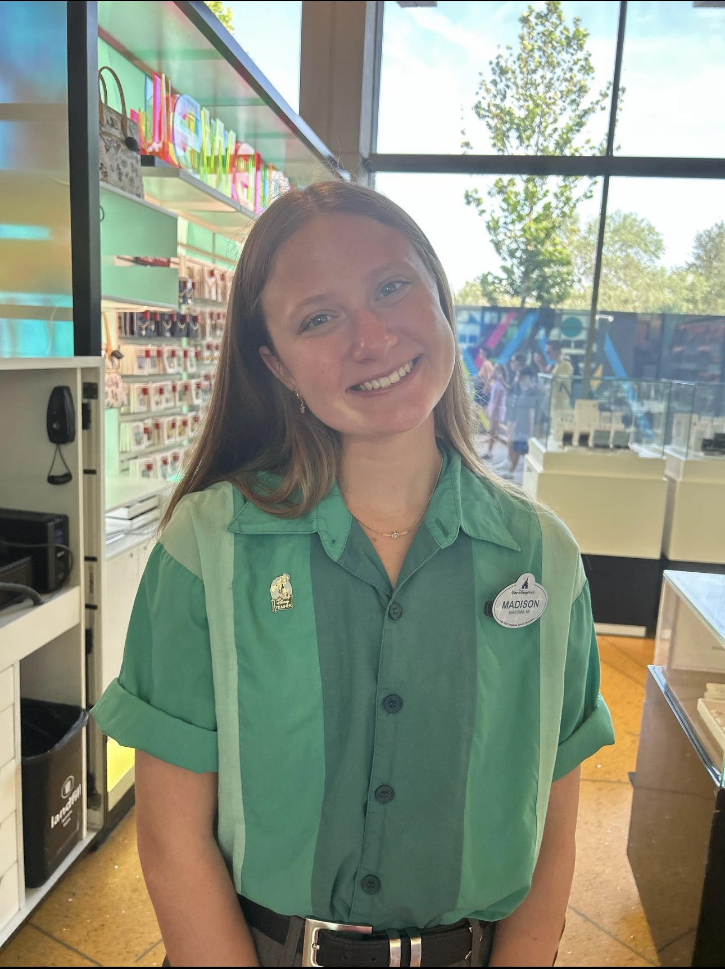
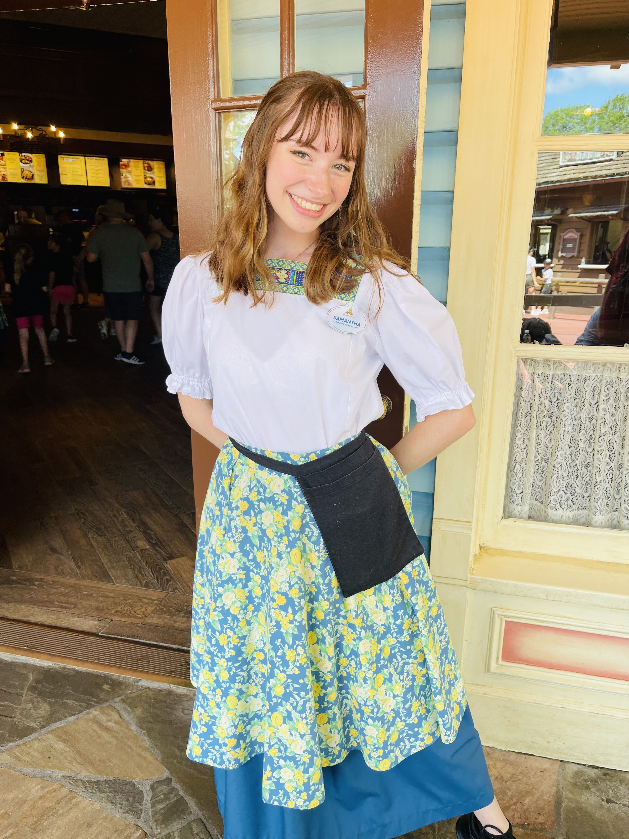
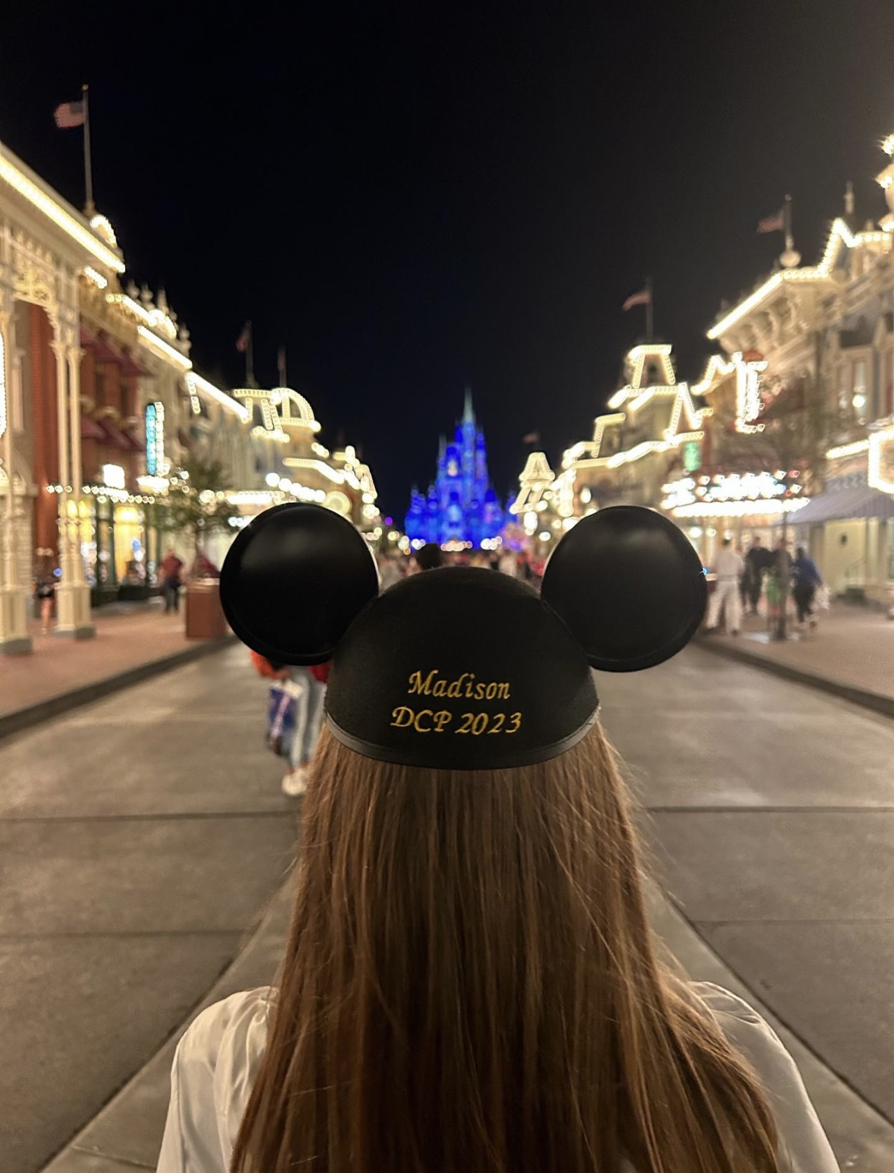
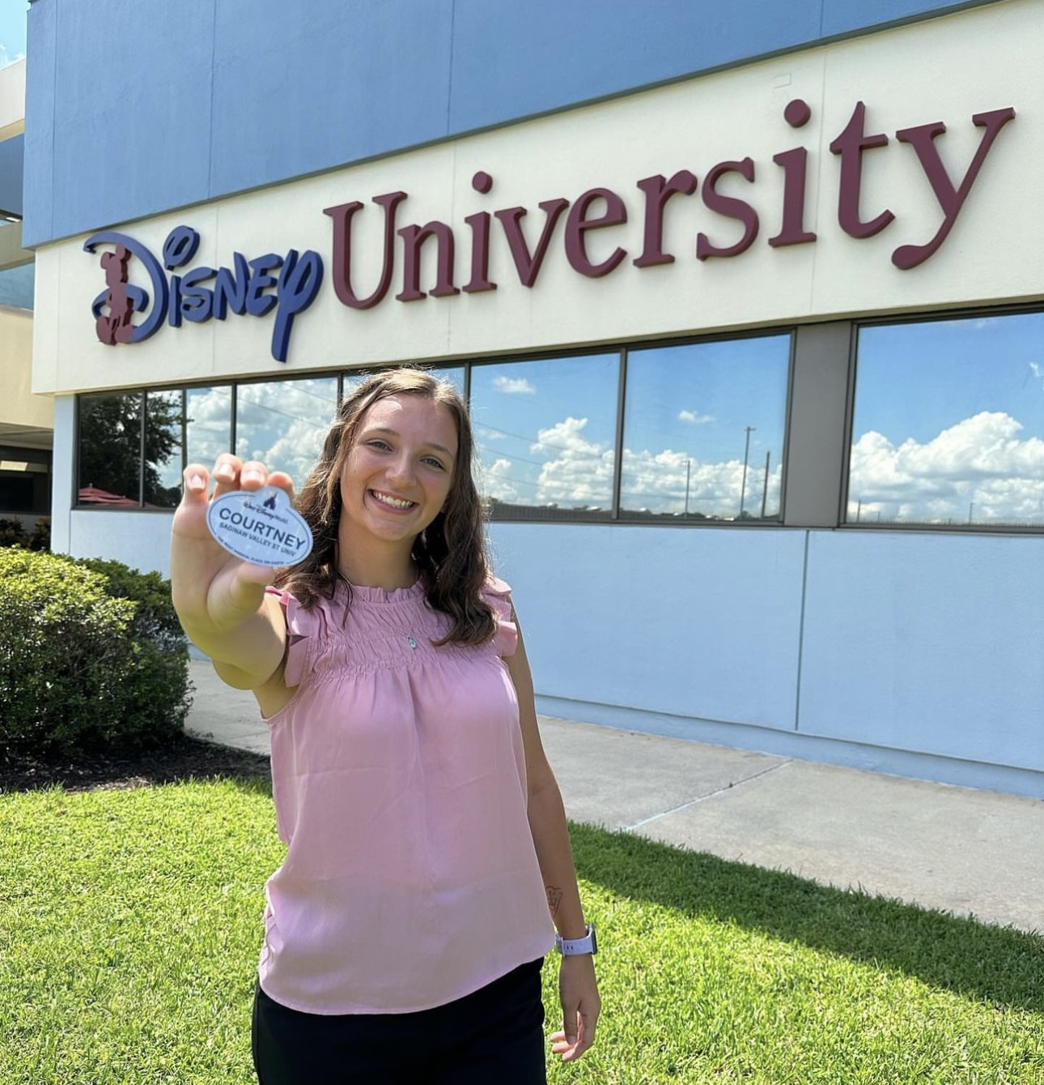
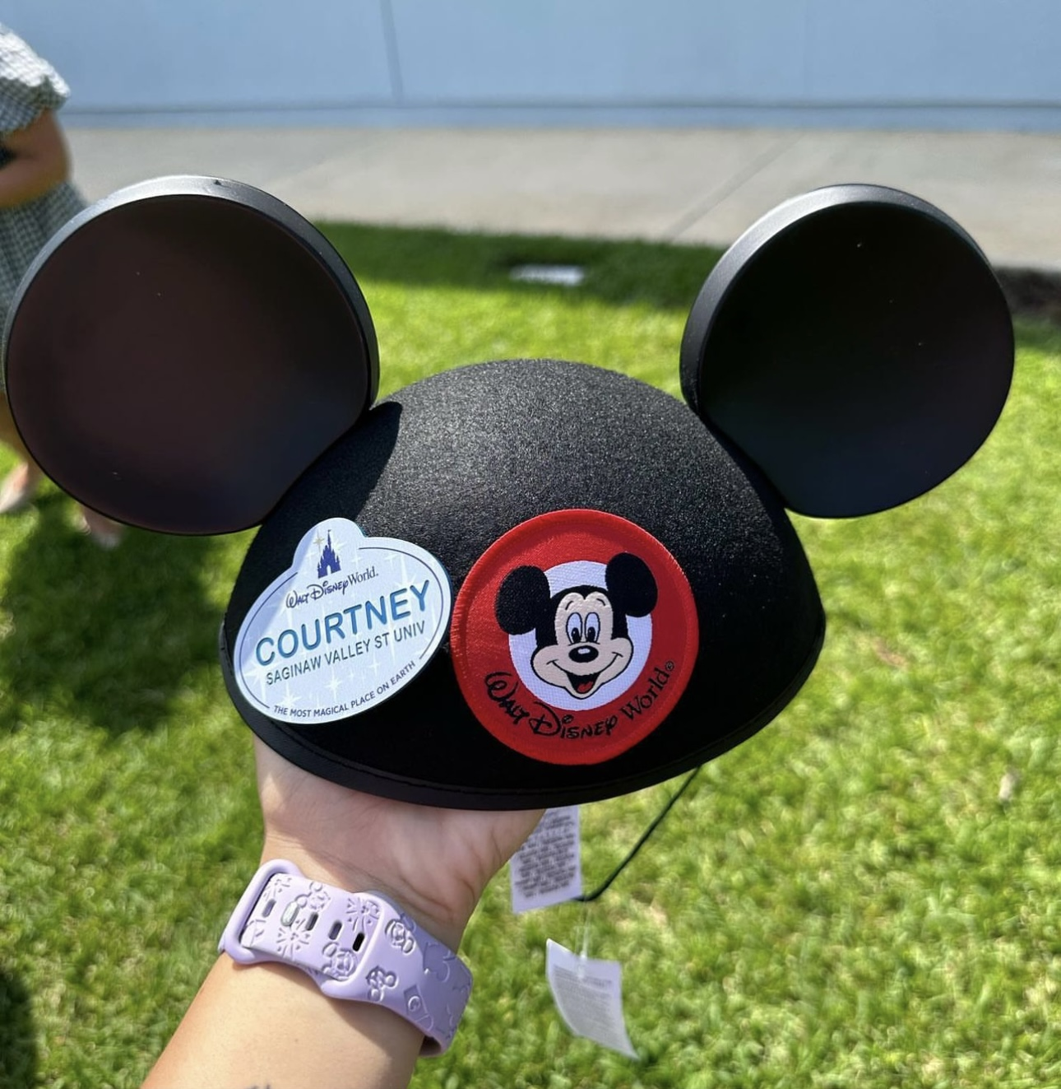
Samantha Carpenter
Courtney Kalkman
Madison Bourgeois

